Slide 1


Slide 2
01
03
Agenda
02
04
Executive Summary
Online vs Offline sales
Insights
Monthly sales overview

Slide 3
Key Performance Indicators
$9M
$140.65M
39.8%
-2.88%
Total Profit
Total Revenue
Online Profit Margin
Offline Profit Margin
Notes:
To set the stage, let’s begin with a summary of key findings. Over the period analyzed, we saw significant growth, with a 640% increase in sales. Online channels showed a strong profit margin of 39.8%, while offline struggled with a negative margin of -2.88%. Our recommendations focus on expanding profitable online segments, optimizing offline categories, and leveraging our top salespeople to improve team performance.

Slide 4
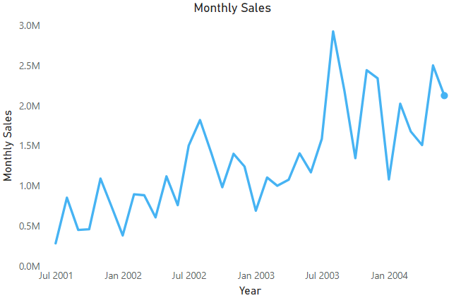
Monthly Sales Overview
Monthly Sales trended up, resulting in a 640% increase between July 2001 and June 2004.
Sales Trend
﻿Monthly Sales started trending up on July 2003, rising by 33.90% in 11 months.﻿

Slide 5
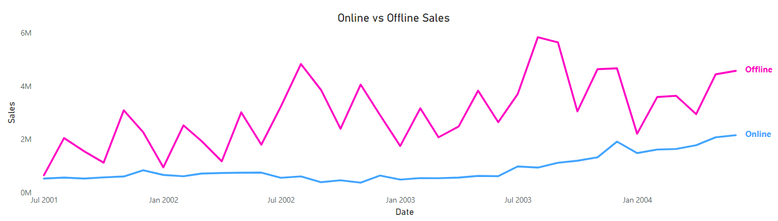
Sales by Channel (Online vs Offline)
We notice that offline sales are larger than online sales, but online sales are increasing. [ correct to be currency]

Slide 6
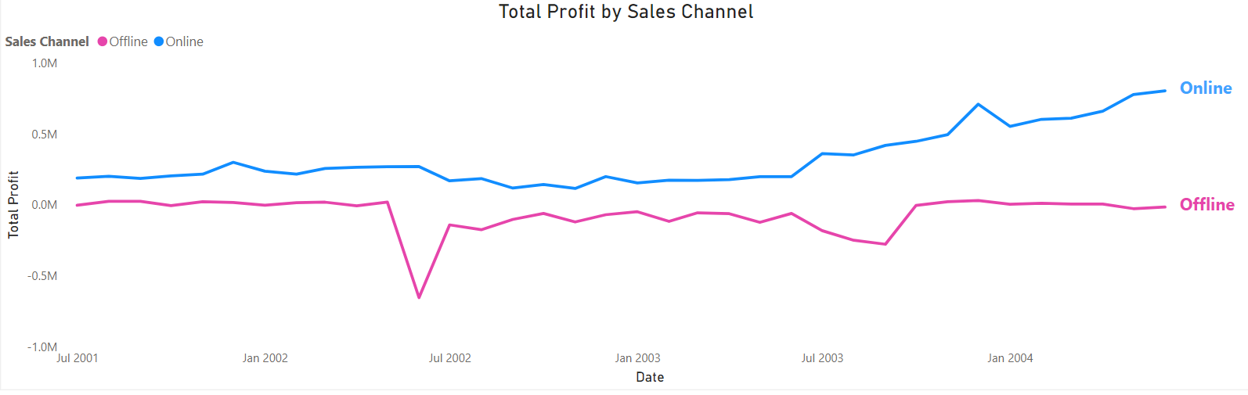
Profit by Online Sales is Higher
Although the offline sales are higher, the profit margin generated by online sales is 39.8%, where offline profit margin is -2.88%

Slide 7
Key Recommendations & Strategic Opportunities
Online sales have outpaced offline sales; focusing on e-commerce could unlock significant revenue growth.
Recommendations
Invest in Online Channels
Enhance Digital Marketing: Allocate more budget to targeted online advertising campaigns.
Expand E-Commerce Platform: Improve user experience on the online store.
Strategic Opportunities
Scalability: Online sales are more scalable, allowing the company to reach broader audiences with less physical infrastructure.

Slide 8


